Slide 1
Lecture 07: Interaction
Chris Walshaw
Computing & Mathematical Sciences
University of Greenwich

Slide 2
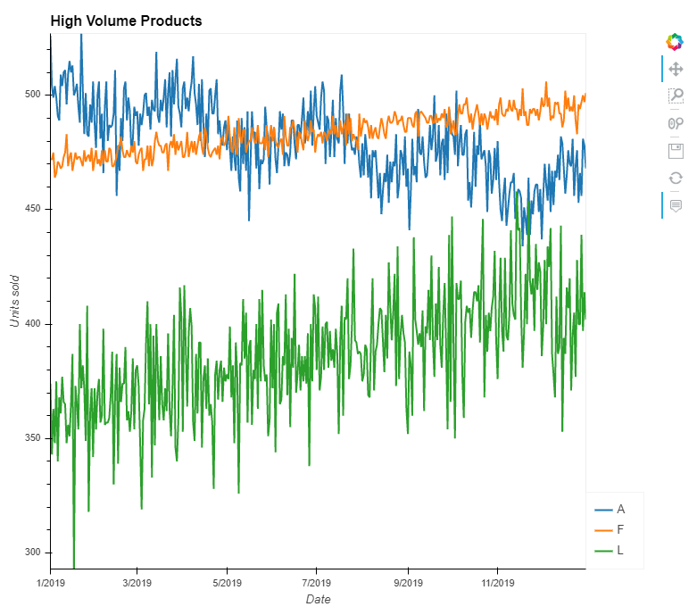
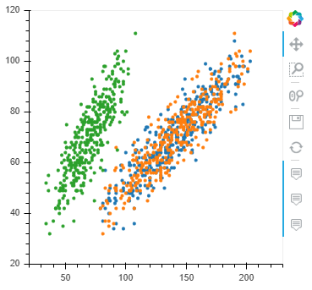
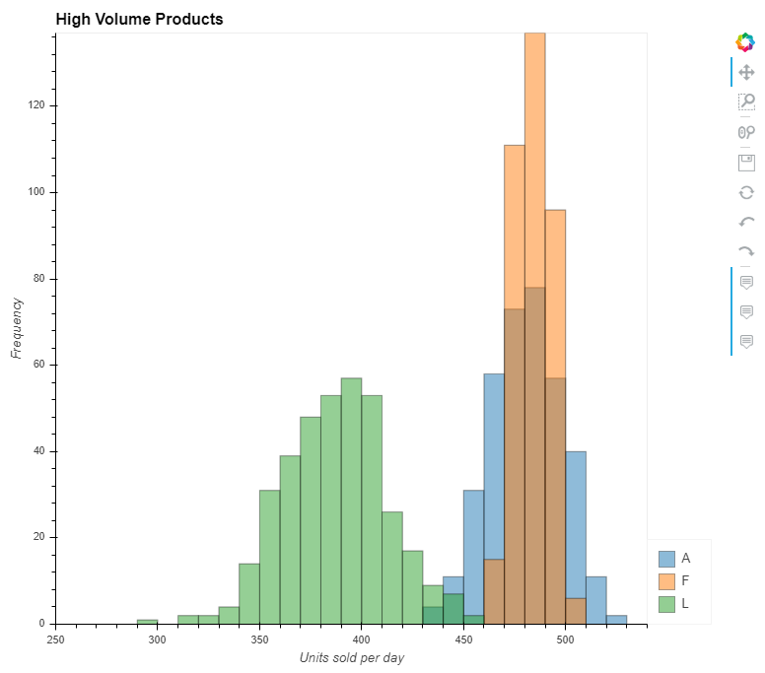
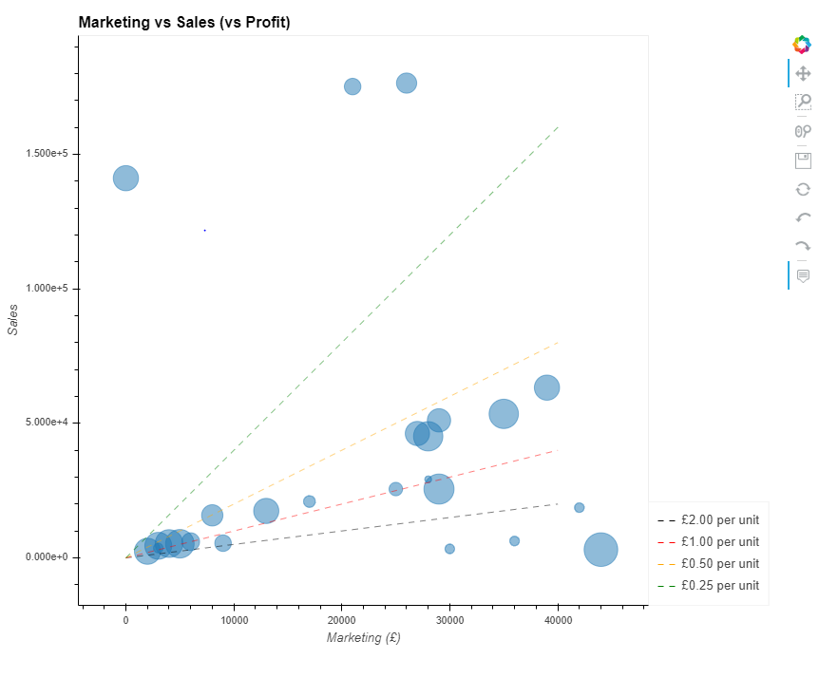
Motivation / Objectives
The company who supplied the data want to know about products that
don’t sell well or
aren’t very profitable or
cost too much to market or …
Over the last 6 weeks we have looked at different aspects of visualisation using different types of chart
This week we take a look at how we might provide interactive versions of some of these charts
line plots
histograms
scatter plots
bubble plots
…

Slide 3
Interaction trade-off
There is a trade-off to using interactive visualisations
sometimes the code can be a bit harder to construct (particularly dashboards – next week)
but the user can do much more with an interactive chart
If you are doing exploratory data analysis for yourself you might not bother
you can just change the code to change the visualisation
although interactive visualisation may save you time in the long run
If you are doing explanatory data analysis for someone else it can be worth the effort
allows the user to really explore the data themselves
more next week!

Slide 4
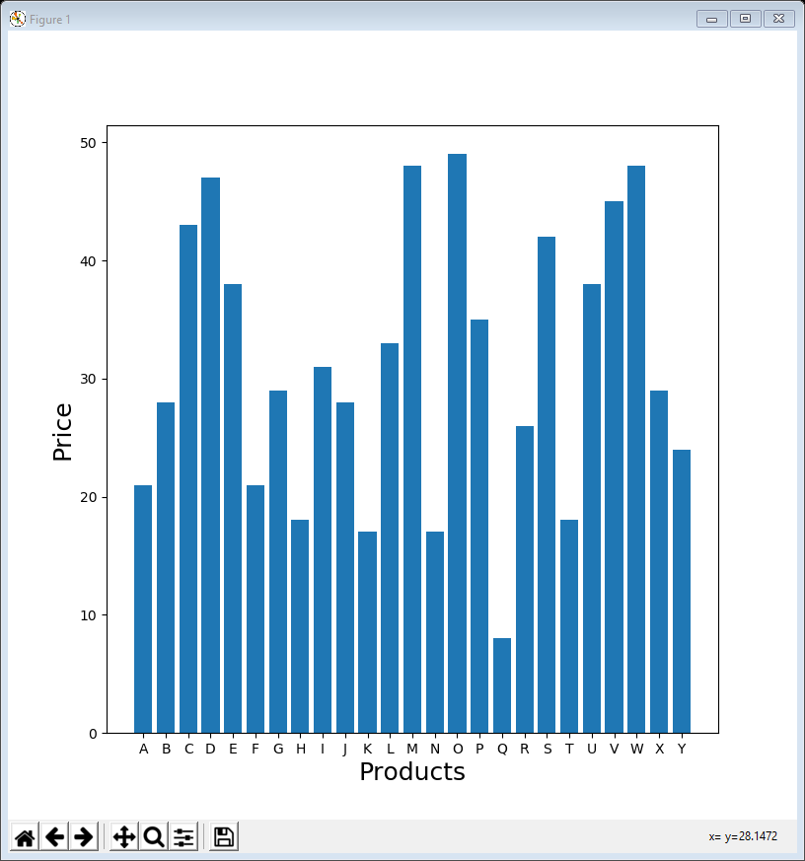
hvPlot / HoloViews / Bokeh
This week we will not be using matplotlib
although strictly speaking standalone matplotlib examples are interactive, using the buttons (bottom left), the interaction is very limited – demo …
… and these don’t work in Colab / Jupyter
Instead we shall be using a different visualisation library called hvPlot which is built on HoloViews and Bokeh
see hvplot.holoviz.org
“hvPlot provides an alternative for the static plotting API provided by Pandas, with an interactive Bokeh-based plotting API that supports panning, zooming, hovering, and clickable/selectable legends”
When you run an hvPlot standalone Python example (a .py file), it creates an HTML page with built-in JavaScript code used to provide the interaction
you don’t need to do any coding in HTML or JavaScript
but you can copy the file onto a website for anyone to look at
When you run an hvPlot example in Jupyter or Colab the HTML / JavaScript appears in the notebook’s output and you can interact with it there

Slide 5
Common features
All of today’s examples contain similar lines of code at the top
import the libraries (sometimes we need holoviews elements too)
read in the daily sales data and convert the index to datetime (same as our other examples)
There are some other minor differences when using Colab or Jupyter – see the end of the lecture notes
import pandas as pd
import hvplot.pandas
data = pd.read_csv('https://tinyurl.com/ChrisCoDV/Products/DailySales.csv’,
index_col=0)
data.index = pd.to_datetime(data.index)
print(data.head())

Slide 6
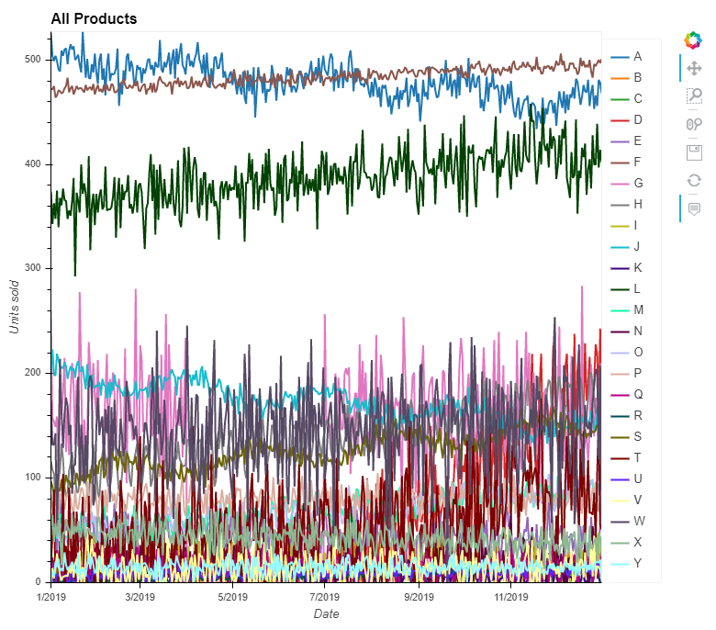
01LinePlot all.py
We can now easily create an interactive line plot with a line for each time-series in the data
This is very similar to the Pandas .plot.line() examples from lecture 01
except we use .hvplot.line() instead and hvplot.show() to show the plot
We are also passing some metadata (frame size, labels, title)
also possible with Pandas but we didn’t bother before
The interactive buttons (top right) aren’t so different from matplotlib
pan, box zoom, wheel zoom, save (as .png), reset - demo
However the interactive legend is new and really useful
just click on a product in the legend to dim / un-dim it - demo
plot = data.hvplot.line(
frame_height=500, frame_width=500,
xlabel='Date', ylabel='Units sold',
title='All Products'
)
hvplot.show(plot)

Slide 7
02LinePlot high volume.py
It is also easy to create line plots for selected products
The only changes are shown in bold
selected = ['A', 'F', 'L']
plot = data[selected].hvplot.line(
frame_height=500, frame_width=500,
xlabel='Date', ylabel='Units sold',
title='High Volume Products'
)
hvplot.show(plot)

Slide 8
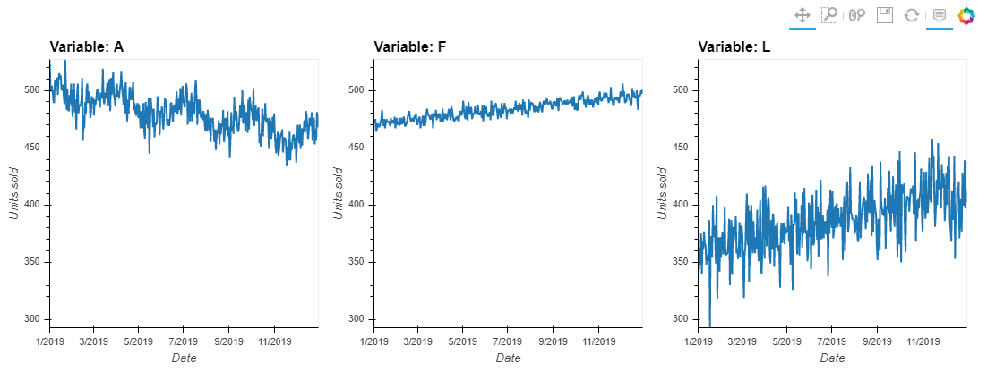
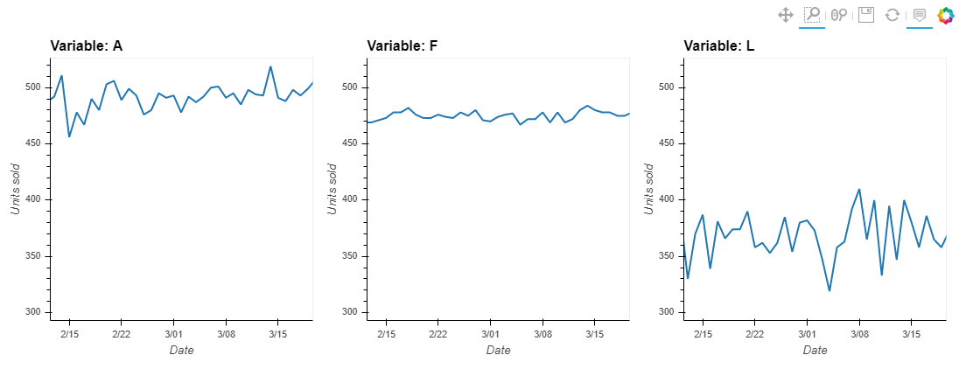
03LinePlot high volume subplots.py
Alternatively use faceting (subplots) to show the lines individually
The one change is shown in bold
just an extra parameter setting
Also, hvPlot connects the axes up when zooming - demo
selected = ['A', 'F', 'L']
plot = data[selected].hvplot.line(
frame_height=300, frame_width=300,
xlabel='Date', ylabel='Units sold',
title='High Volume Products',
subplots=True
)
hvplot.show(plot)

Slide 9
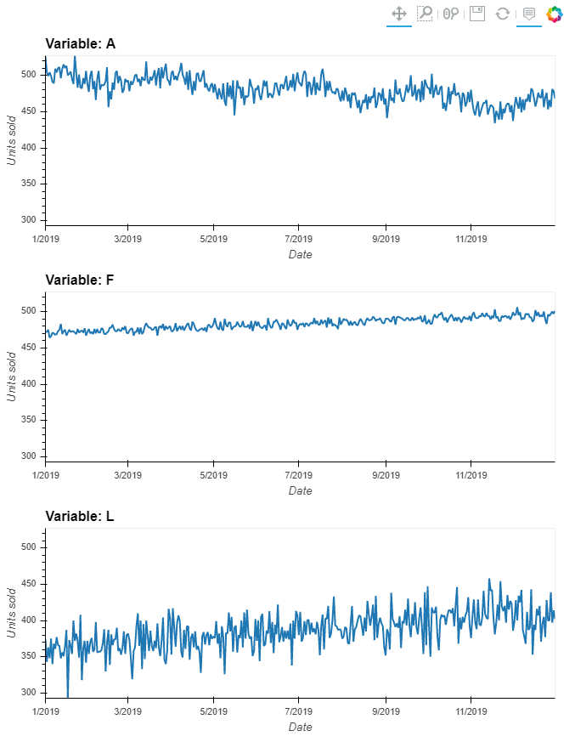
04LinePlot high volume subplots vertical.py
Almost as easy to create a vertical column of plots
The change is in bold
selected = ['A', 'F', 'L']
plot = data[selected].hvplot.line(
frame_height=200, frame_width=600,
xlabel='Date', ylabel='Units sold',
title='High Volume Products',
subplots=True
).cols(1)
hvplot.show(plot)

Slide 10

05LinePlot high volume subplots tools.py
By default, hvPlot includes pan, box zoom, wheel zoom, save (as .png) & reset tools
however, it’s possible to add to these
Changes are shown in bold again
when you specify the list of tools, none are included by default, so most of the list are reinstating the defaults
however, the new ones (undo, redo and hover) are really useful - demo
selected = ['A', 'F', 'L']
plot = data[selected].hvplot.line(
frame_height=200, frame_width=600,
xlabel='Date', ylabel='Units sold',
title='High Volume Products',
tools=['pan', 'box_zoom', 'wheel_zoom', 'undo', 'redo', 'hover', 'save', 'reset'],
subplots=True
).cols(1)
hvplot.show(plot)

Slide 11
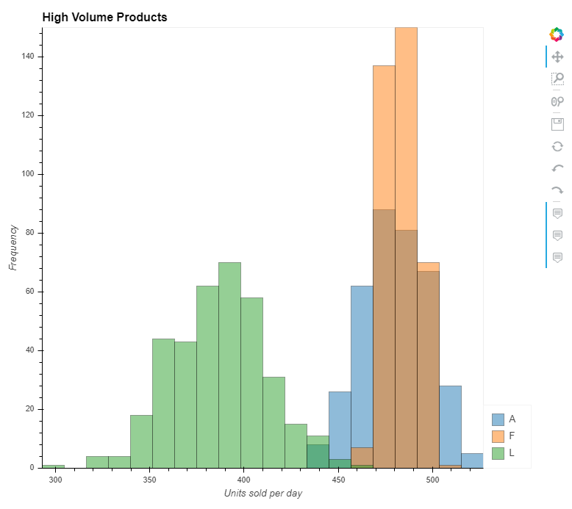
06Histogram high volume.py
Of course, hvPlot can do other types of chart / plot
the next 2 examples are histograms for high volume products
The main changes are shown in bold – essentially just changing .line() to .hist() and adjusting the labels
The alpha parameter makes the bars semi-transparent
can also use with other types of plot
The muted parameters mean that when you click on an item in the legend, its histogram disappears rather than being dimmed – demo
can also use with other types of plot
selected = ['A', 'F', 'L']
plot = data[selected].hvplot.hist(
frame_height=500, frame_width=500,
xlabel='Units sold per day', ylabel='Frequency',
title='High Volume Products',
alpha=0.5, muted_alpha=0, muted_fill_alpha=0, muted_line_alpha=0,
tools=['pan', 'box_zoom', 'wheel_zoom', 'undo', 'redo', 'hover', 'save', 'reset']
)
hvplot.show(plot)

Slide 12
07Histogram high volume custom bins.py
Can also set up the bin sizes ourselves
The changes are shown in bold
although the bin calculations are exactly the same as lecture 05
Now the bins are 10 units wide and aligned on tick marks
x_min = 250
x_max = 550
bin_width = 10
n_bins = int((x_max - x_min) / bin_width)
print(str(n_bins) + ' bins')
bins = [(x_min + x * (x_max - x_min) / n_bins) for x in range(int(n_bins))]
plot = data[selected].hvplot.hist(
frame_height=500, frame_width=500,
xlabel='Units sold per day', ylabel='Frequency',
title='High Volume Products',
alpha=0.5, muted_alpha=0, muted_fill_alpha=0, muted_line_alpha=0,
tools=['pan', 'box_zoom', 'wheel_zoom', 'undo', 'redo', 'hover', 'save', 'reset'],
bins=bins
)
hvplot.show(plot)

Slide 13
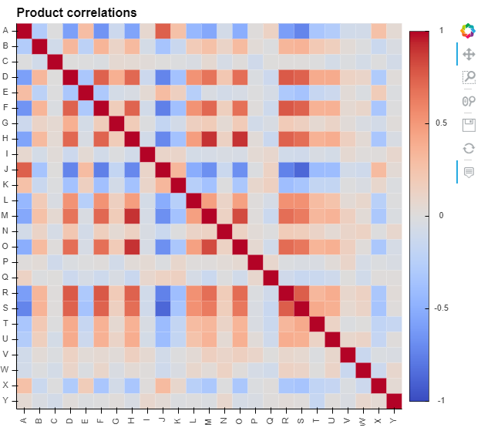
08HeatMap correlation.py
The heatmap code is shown below
The cmap parameter refers to a colour-map – in this case coolwarm
for alternatives see http://holoviews.org/user_guide/Colormaps.html
By default, hvPlot draws the diagonal bottom-left to top-right
the invert_yaxis option draws it top-left to bottom-right (like Seaborn)
The hvPlot colour-map matches the values in the correlation
so if the smallest value is -0.5, it will be shown as the darkest blue
clim corrects this so that -1 is mapped to the darkest blue (like Seaborn)
plot = data.corr().hvplot.heatmap(
frame_height=500, frame_width=500,
title='Product correlations',
rot=90, cmap='coolwarm'
).opts(invert_yaxis=True, clim=(-1, 1))
hvplot.show(plot)

Slide 14
Composing plots
Having identified correlations (again) in the heatmap we might want to create scatter plots of strongly correlated variables
as before (lecture 04), these are H, M & O
Although we can easily create a scatter plot of any pair, there’s no one function that will do scatter plots of multiple arbitrary pairs like this
Instead, hvPlot offers a really neat way to compose two plots together
if you “add” the plots together, using +, they appear side-by-side and (where possible) their axes are connected
if you “multiply” the plots, using *, they are overlaid on top of each other
This can create really long lines of code, so use backslash (the \ symbol) to continue on to another line

Slide 15
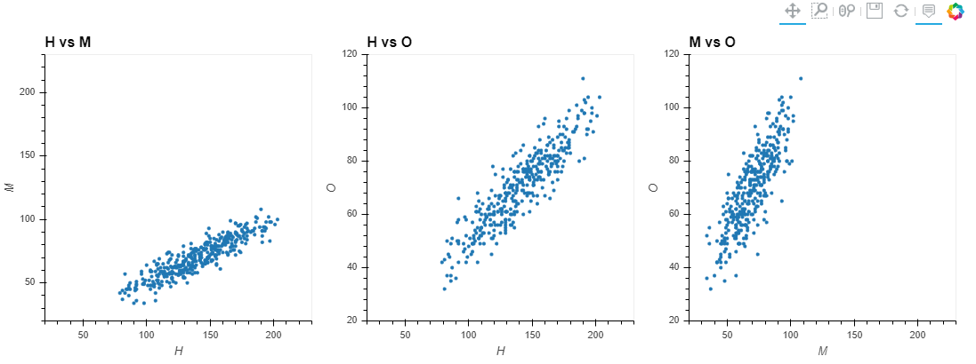
09ScatterPlots selected correlations.py
The code below creates scatter plots of H, M & O against each other
Looks a little complicated initially but it’s just 3 separate plots “added” together with line continuations (backslashes) after each addition
the xlim / ylim parameters just set the same x / y limits on each plot
the size parameter sets the size of the dots
xlimits = (20, 230)
ylimits = (20, 120)
plot = data.hvplot.scatter(
frame_height=300, frame_width=300,
x='H', y='M', title='H vs M',
xlim=xlimits, ylim=ylimits, size=10
) + \
data.hvplot.scatter(
frame_height=300, frame_width=300,
x='H', y='O', title='H vs O',
xlim=xlimits, ylim=ylimits, size=10
) + \
data.hvplot.scatter(
frame_height=300, frame_width=300,
x='M', y='O', title='M vs O',
xlim=xlimits, ylim=ylimits, size=10
)
hvplot.show(plot)

Slide 16
10ScatterPlot selected correlations.py
If you change + to * the scatter plots are overlaid on top of each other
Each overlay gets a different colour
However now it no longer makes sense to label axes
the x-axis is sometimes H and sometimes M
the y-axis is sometimes M and sometimes O
So this plot is hard to interpret despite presenting similar info to example 09
plot = data.hvplot.scatter(
frame_height=300, frame_width=300,
x='H', y='M', xlabel='', ylabel=‘’,
xlim=xlimits, ylim=ylimits, size=10
) * \
data.hvplot.scatter(
frame_height=300, frame_width=300,
x='H', y='O', xlabel='', ylabel='',
xlim=xlimits, ylim=ylimits, size=10
) * \
data.hvplot.scatter(
frame_height=300, frame_width=300,
x='M', y='O', xlabel='', ylabel='',
xlim=xlimits, ylim=ylimits, size=10
)
hvplot.show(plot)

Slide 17
Bubble plots
For the multi-dimensional per product data we will construct bubble plots, same as lecture 06
The data is read in and then the summary_data dataframe is constructed, as before
summary_data = pd.DataFrame(index=data.columns)
summary_data['Price'] = price_per_unit.values
summary_data['Profit'] = profit_per_unit.values
summary_data['Sales'] = data.sum().values
summary_data['Marketing'] = marketing_data.values
summary_data['Advertising'] = summary_data['Marketing'] / summary_data['Sales']
summary_data['Cost'] = summary_data['Price'] - summary_data['Profit']
print(summary_data.head())
print(summary_data.describe())

Slide 18
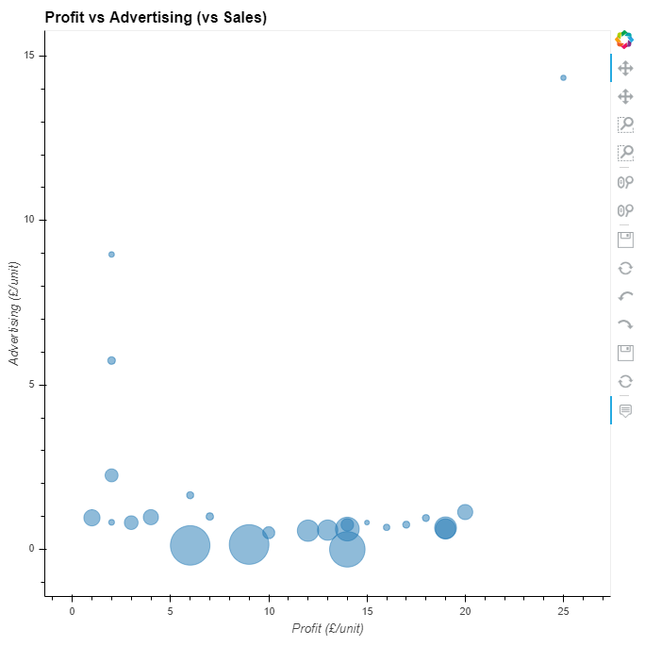
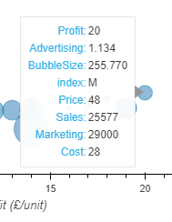
11BubblePlot profit advertising sales.py
To turn a scatter plot into a bubble plot, just set the bubble size in another column of the dataframe
Then pass the bubble size in as a parameter
The following parameters are also very useful
alpha makes the bubbles semi-transparent
padding stops bubbles from overlapping the edge of the plot
hover_cols='all' means that the hovertool displays all variables (not just x, y & bubble size) – can also customise this
summary_data['BubbleSize'] = summary_data['Sales'] * 0.01
plot = summary_data.hvplot.scatter(
frame_height=500, frame_width=500,
title='Profit vs Advertising (vs Sales)',
xlabel='Profit (£/unit)', ylabel='Advertising (£/unit)',
alpha=0.5, padding=0.1, hover_cols='all',
tools=['pan', 'box_zoom', 'wheel_zoom', 'undo', 'redo', 'hover', 'save', 'reset'],
x='Profit', y='Advertising', size='BubbleSize'
)
hvplot.show(plot)

Slide 19
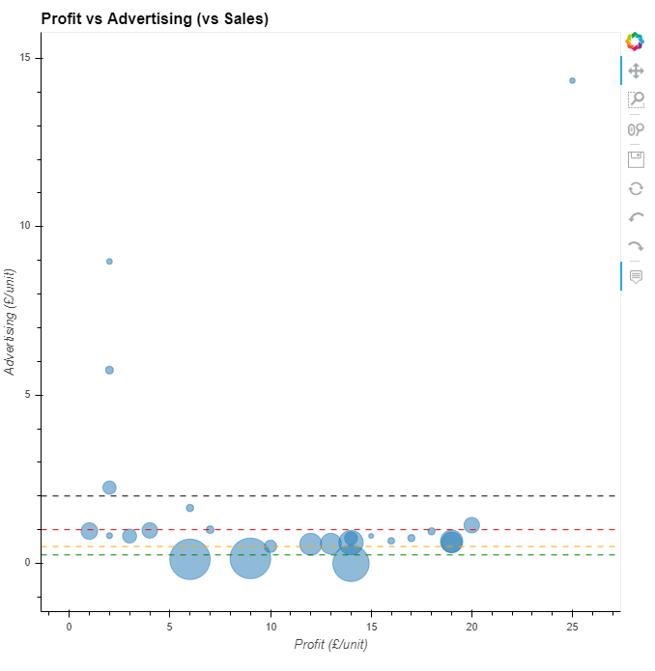
12BubblePlot profit advertising sales limits.py
To include limit lines, as before, can create and overlay horizontal lines using holoviews.HLine()
hline200 = hv.HLine(2.00, label='£2.00 per unit')
.opts(line_dash='dashed', line_width=0.5, color='black')
hline100 = hv.HLine(1.00, label='£1.00 per unit')
.opts(line_dash='dashed', line_width=0.5, color='red')
hline050 = hv.HLine(0.50, label='£0.50 per unit')
.opts(line_dash='dashed', line_width=0.5, color='orange')
hline025 = hv.HLine(0.25, label='£0.25 per unit')
.opts(line_dash='dashed', line_width=0.5, color='green')
plot = summary_data.hvplot.scatter(
... # unchanged
) * \
hline200 * \
hline100 * \
hline050 * \
hline025
hvplot.show(plot)

Slide 20
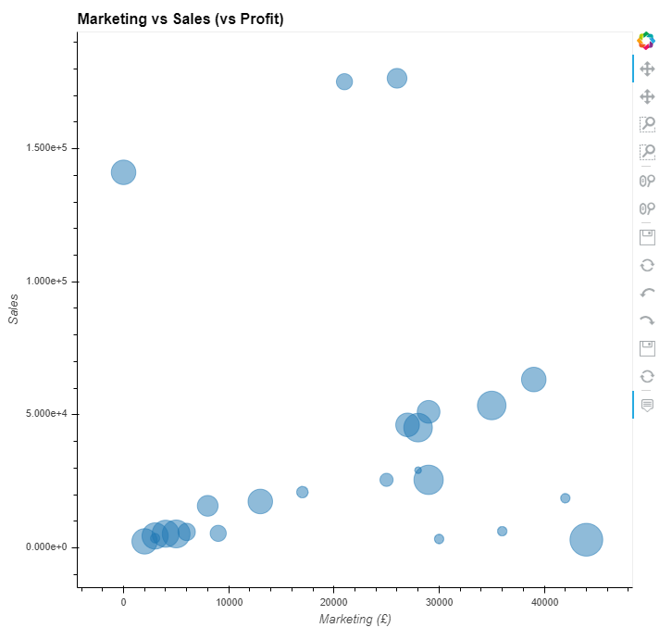
13BubblePlot marketing sales profit.py
Example 13 is an interactive version of example 10 from last week
summary_data['BubbleSize'] = summary_data['Profit'] * 50
plot = summary_data.hvplot.scatter(
frame_height=500, frame_width=500,
title='Marketing vs Sales (vs Profit)',
xlabel='Marketing (£)', ylabel='Sales',
alpha=0.5, padding=0.1, hover_cols='all',
tools=['pan', 'box_zoom', 'wheel_zoom', 'undo', 'redo', 'hover', 'save', 'reset'],
x='Marketing', y='Sales', size='BubbleSize'
)
hvplot.show(plot)

Slide 21
14BubblePlot marketing sales profit limits.py
Example 14 includes the limit lines too
since the lines are not horizontal we use holoviews.Curve()
hline200 = hv.Curve([(0, 0), (40000, 20000)], label='£2.00 per unit’)
.opts(line_dash='dashed', line_width=0.5, color='black')
hline100 = hv.Curve([(0, 0), (40000, 40000)], label='£1.00 per unit’)
.opts(line_dash='dashed', line_width=0.5, color='red')
hline050 = hv.Curve([(0, 0), (40000, 80000)], label='£0.50 per unit’)
.opts(line_dash='dashed', line_width=0.5, color='orange')
hline025 = hv.Curve([(0, 0), (40000, 160000)], label='£0.25 per unit’)
.opts(line_dash='dashed', line_width=0.5, color='green')
plot = summary_data.hvplot.scatter(
... # unchanged
) *\
hline200 *\
hline100 *\
hline050 *\
hline025
hvplot.show(plot)

Slide 22
Changes for notebooks
Python notebooks need some changes
In Colab
at the top
!pip install hvplot
import holoviews as hv
in every code cell, replace “hvplot.show(plot)” with
hv.extension('bokeh')
plot
In Jupyter
you can do exactly the same as above for Colab …
… this will work but make the run-time very slow
Alternatively, in Jupyter
make sure hvplot is installed (use “pip install hvplot” in a command prompt)
in every code cell, replace “hvplot.show(plot)” with
plot

Slide 23
Lecture summary
No particular data conclusions this week
Looked at creating interactive visualisations
line plots
histograms
heatmaps
scatter plots
bubble plots
… and others are possible
Interactive visualisations
sometimes take a little more effort (although this week they are fairly straightforward)
but give the user many more options to explore the data for themselves

